Slide 1
Methods for data inclusion in System Dynamic models
James Houghton
Michael Siegel, Daniel Goldsmith, Allen Moulton, Stuart Madnick, Anton Wirsch
Notes:
My name is James Houghton,
this presentation grows out of
the work of my research group at MIT Sloan School of Management.
I have 3 goals for this presentation:
To motivate the use of measurement data with models
To demonstrate some interesting data techniques
As it’s the last session before we all get on a boat - to avoid putting everyone to sleep
To get started, I’d like to go back a bit and discuss
a pioneer in the integration of models and data.

Slide 2
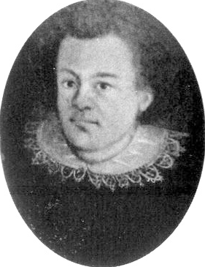
Notes:
Way back. – 1589, to be precise
Where a young Johannes Kepler is studying
to be a Lutheran Minister.
He’s got it all figured out –
the pulpit is his ticket from a life of poverty to a life of ease.
He’s smart, works hard, and reads widely.
But one day, he encounters a book
that changes his worldview entirely.
How many of you have had that sort of experience? <hands?>
For me it was ‘Thinking in Systems’ by Donella Meadows.
For Kepler, the book was “On the revolutions of the heavenly spheres” by Copernicus

Slide 3
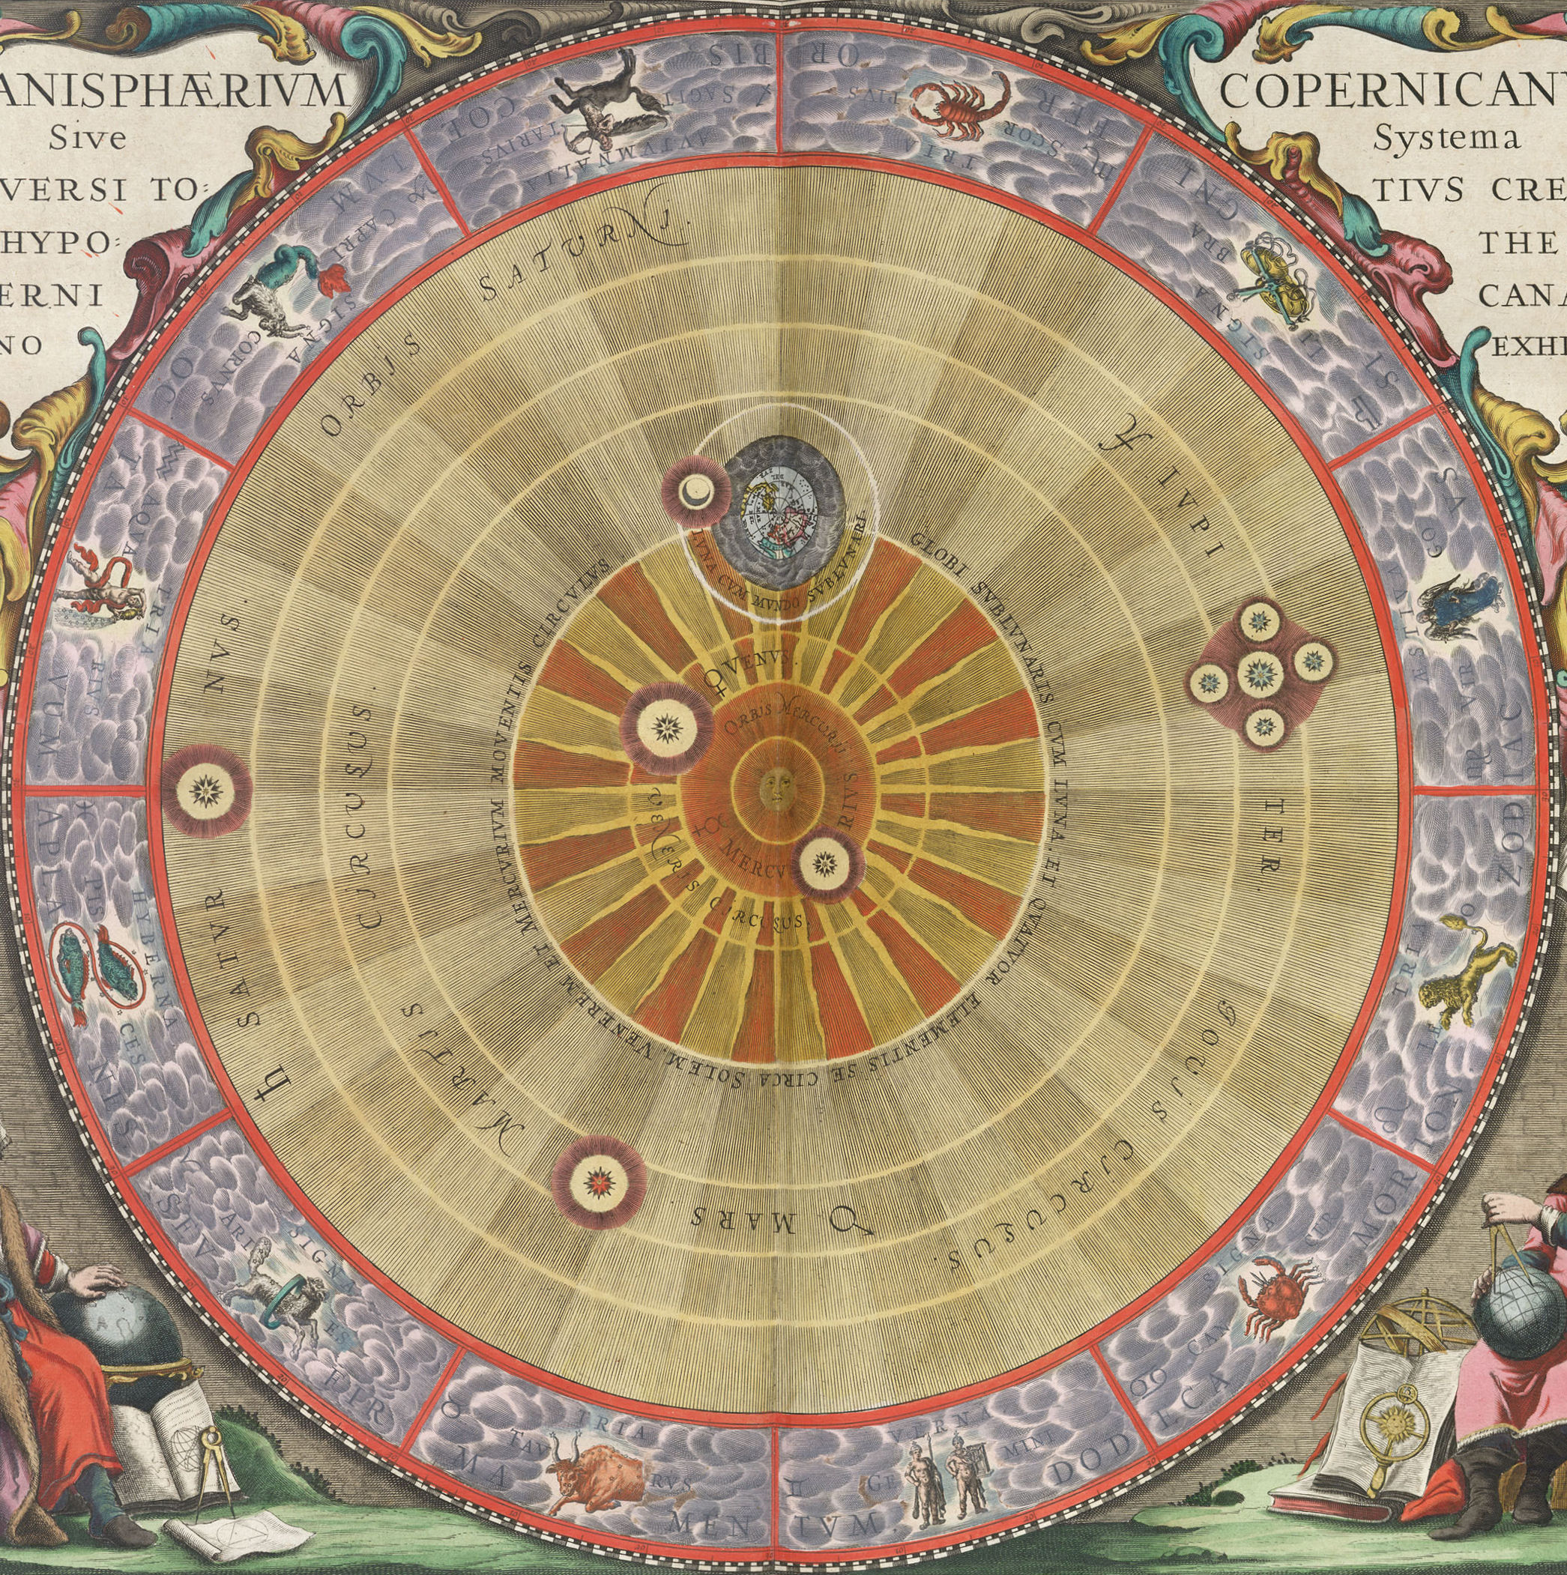
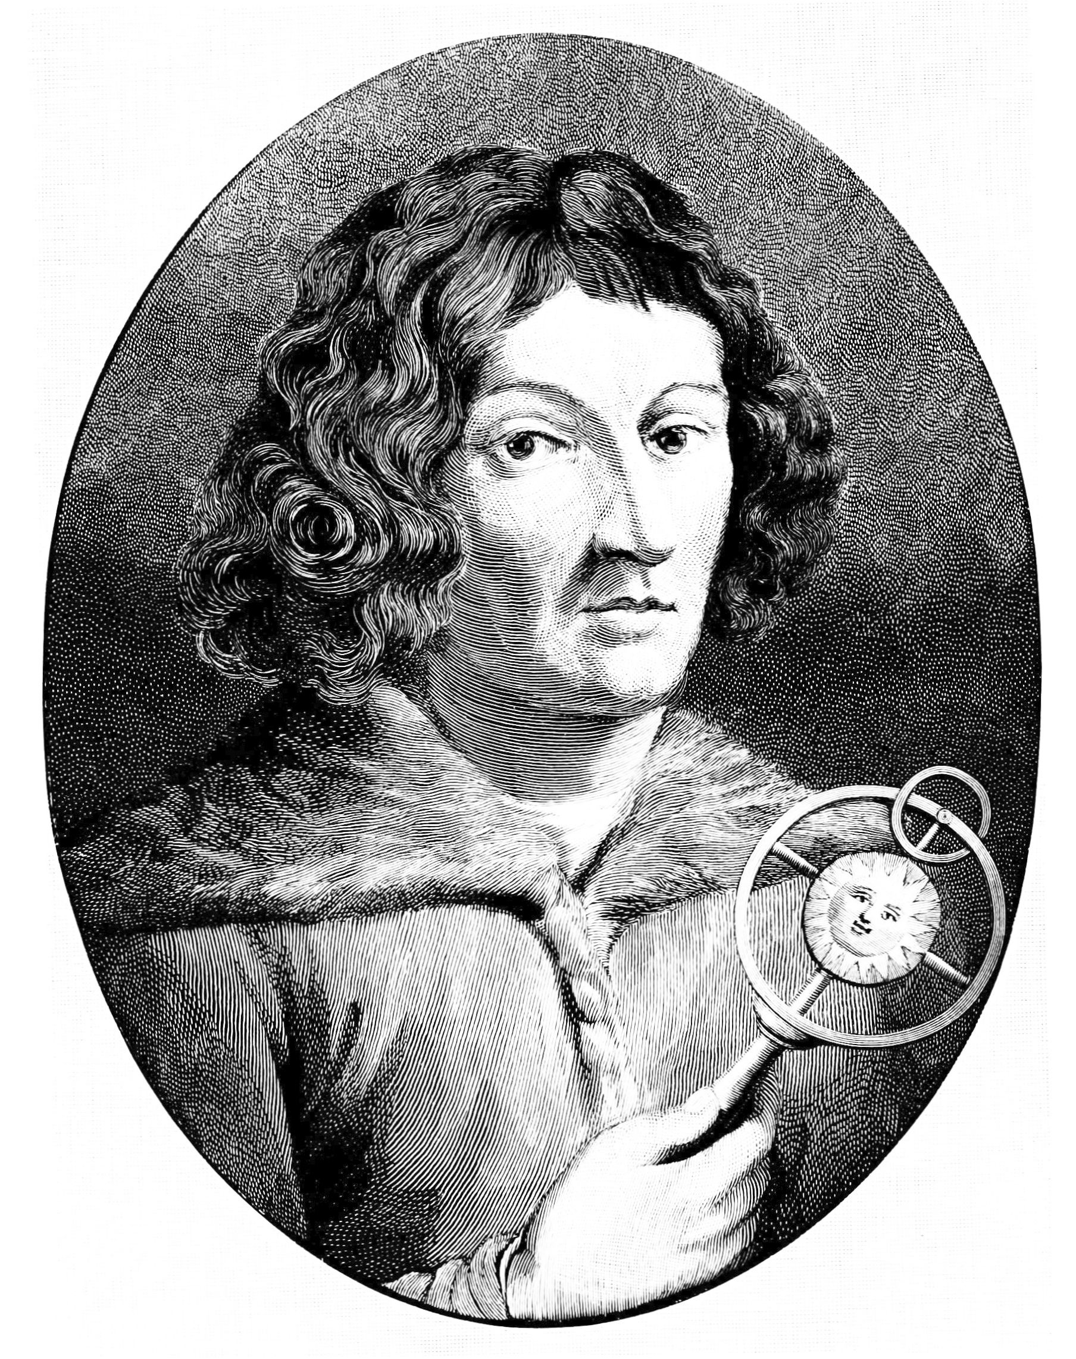
Notes:
In his book, Copernicus describes a model of a solar system
where the planets orbit the sun instead of orbiting the earth. Crazy.
Kepler has a conversion experience –
which you may imagine is not always a good idea
for someone who is already studying to be a minister.
This is usually called ‘heresy’.
And kepler’s school masters thought so as well –
heliocentrism was distinctly ‘non-orthodox’
and they couldn’t have a heretic in the pulpit.
So they found a convenient way to get rid of him.
They sent him to be a math instructor in Austria.

Slide 4
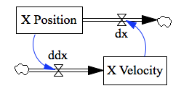
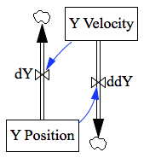
Notes:
Now, you and I know that the gravitational attraction between the sun and earth
causes both to oscillate around their joint center of mass,
We would model the system as a pair of independent simple harmonic oscillators,
and run simulations to get a sense of the behavior.

Slide 5
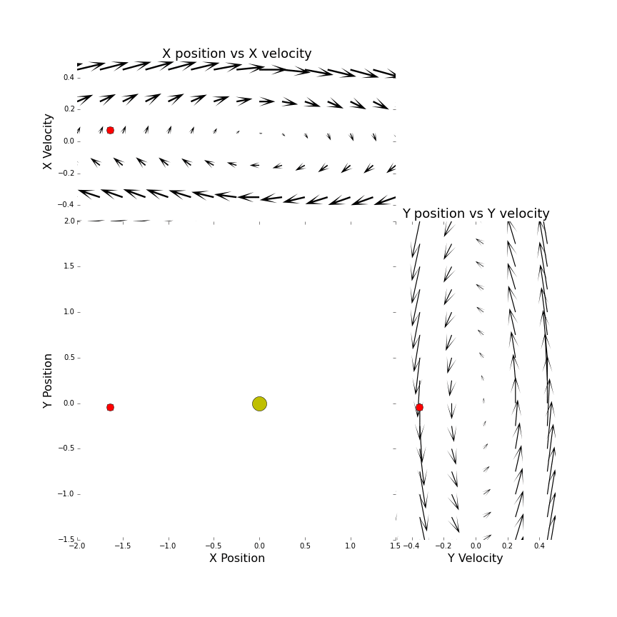
Data Method 1:Phase Portraits
Notes:
This is a great opportunity to look at our first data method:
phase portraits.
We can draw a phase portrait for each of the independent axes.
To do so, we initialize our model in a range of possible states,
and chart the instantaneous change in state with an arrow.
If we plot our measured data on top of the phase plot,
we get a quick sense of how well the model agrees with data.
Here we see the orbit of mars in its progression around the sun,
and that its x and y components are fairly well aligned with our model.

Slide 6
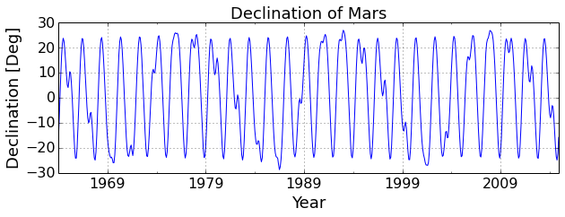
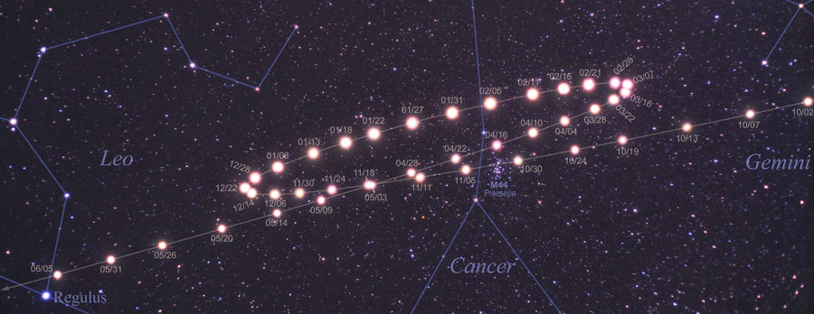
Declination
Hour Angle
Notes:
In his new appointment in Graz,
Kepler begins to take himself seriously as a mathematician, and astronomer.
He starts looking at the problem of retrograde motion
in which the planets seem to move backward in their progression across the sky.
Here we see the vertical component of mars motion against the stars.
What’s going on here?
There seem to be several repeating patterns
all lined up on top of one another.
Is there a way we can separate those out to have a look at them?

Slide 7
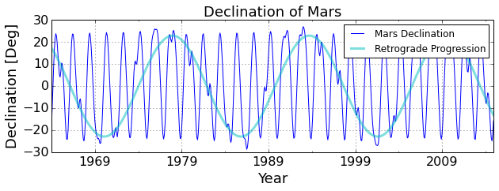
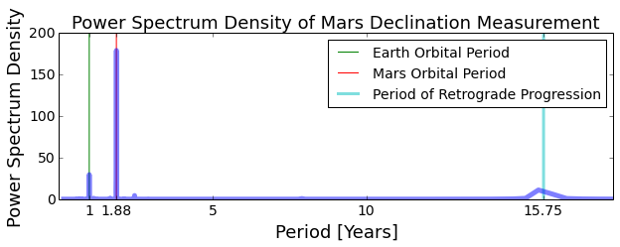
Data Method 2: Spectral Analysis
Notes:
Turns out, there is. Data method 2: Spectral Analysis.
Here we use a Fast Fourier Transform to look at the frequency components of this signal,
here plotted according to period.
We can see that there is a peak at the orbital periods of both Mars and the Earth.
Additionally, we see an approximately 15 year cycle, which
foreshadows something kepler will discover only years later:
that the orbit of the planet mars is not actually round, but elliptical.

Slide 8
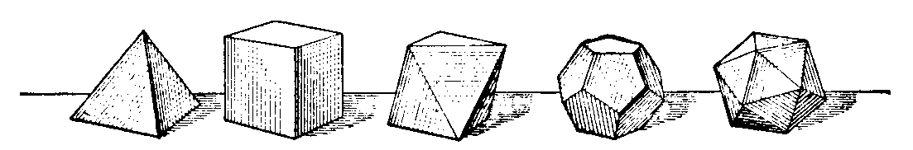
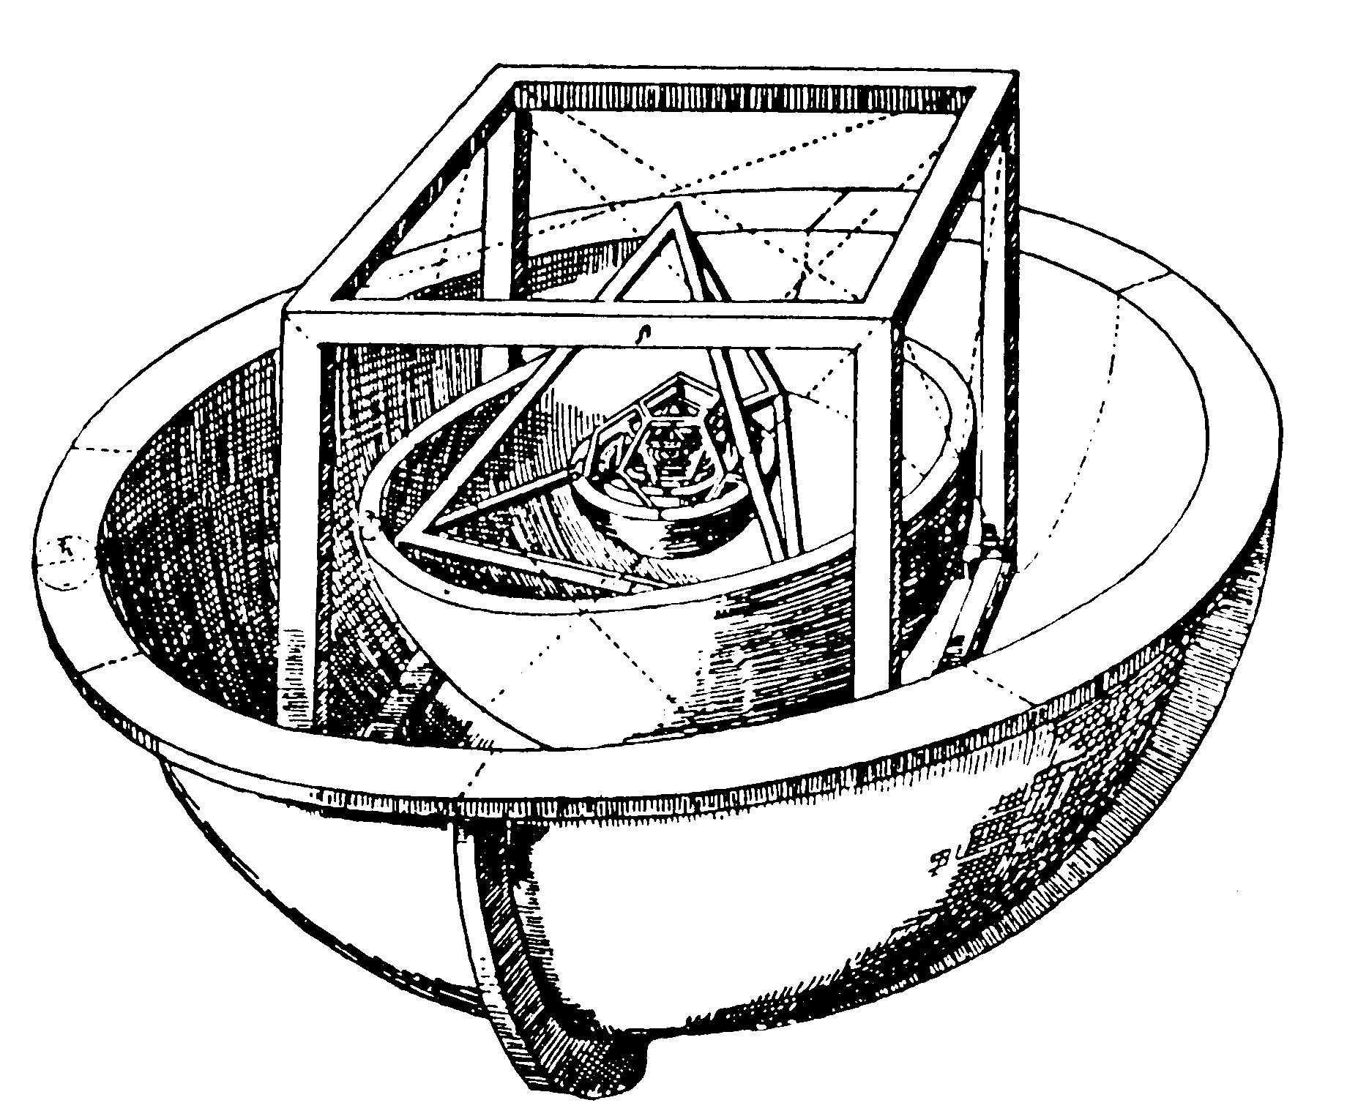
Notes:
Kepler also tries to improve on Copernicus’ measurements
of the distances between the planets and the sun.
And he postulates that the orbital distances
can be explained by nesting the crystal spheres which hold the planets
alternately with the five platonic solids. – shapes whose faces are regular polygons.
Now this sounds a little odd to us, but Kepler believed
that this was God’s deliberate construction
designed to show his power and beauty.
Unfortunately, despite being beautiful, this model wasn’t very accurate.

Slide 9
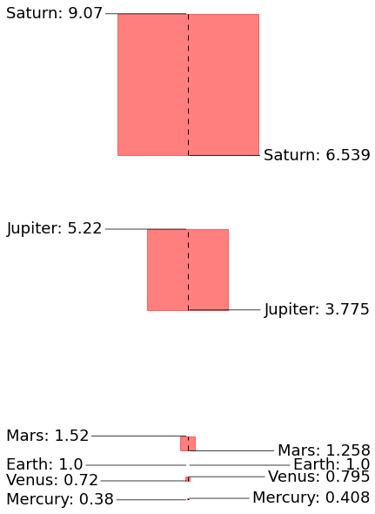
Data Method 3: Summary Statistics
Sum of square errors
Errors:
Sum to 4.1 AU
Average to 0.69 AU/planet
Copernicus’s Measurements [AU]
Platonic Solid Model Predictions [AU]
Sum of Squared Errors:
8.6 AU²
Notes:
To get a sense for the accuracy of this model,
lets use Data Method 3: summary statistics.
I always find these a bit unintuitive, so lets break it down visually.
Here we see the Copernicus’s measurements on the left,
and Kepler’s Model Predictions on the right.
The simplest way to summarize the error is to linearly sum the errors for each planet – shown by the dashed lines.
Alternately, we can sum the squares of the errors – shown by the red shaded region.
This would penalize large deviations (such as Saturn’s)
more than smaller ones (Such as Mercury’s)

Slide 10
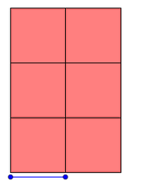
Data Method 3: Summary Statistics
Errors:
Sum to 4.1 AU
Average to 0.69 AU/planet
Copernicus’s Measurements [AU]
Platonic Solid Model Predictions [AU]
Sum of Squared Errors:
8.6 AU²
Mean Squared Error:
1.4 AU²/planet
Root Mean Squared Error:
1.2 AU/planet
Notes:
If we divide the sum of squared error by the number of planets – here with the black rectangles
we get the mean square error
which lets us know about how wrong we are for each planet.
And taking the square root of this – the blue line
we can show a weighted error in the same units as the original data
This is the Root Mean Squared Error.
Here we see that the RMSE of Kepler’s predictions
is more than the distance between the earth and the sun. Not great.

Slide 11
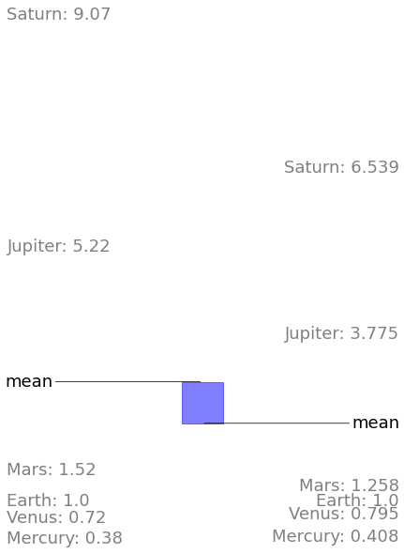
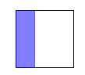
Data Method 3: Summary Statistics
Bias Error:
.47 AU² = 33.3%
Copernicus’s Measurements [AU]
Platonic Solid Model Predictions [AU]
Notes:
Lets look at the Theil statistics.
Here we decompose the error to determine its source.
If we square the error of the averages of each dataset,
we reveal the component due to bias in the prediction.
If we compare this to the
total mean square error, <again the black rectangle>
we see that bias is responsible for 33% of the total.
This is because kepler scaled his predictions
such that the orbital distance of the earth was the same in both sets,
instead of scaling by the mean.

Slide 12
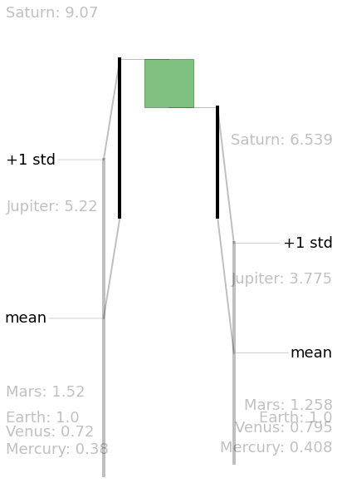
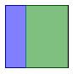
Data Method 3: Summary Statistics
Bias Error:
.47 AU² = 33.3%
Variance Error:
.95 AU² = 66.3%
Remainder:
Covariance Error:
.005 AU² = 0.4%
Copernicus’s Measurements [AU]
Platonic Solid Model Predictions [AU]
Notes:
If we square the error in the standard deviation
we see that differences in variance are responsible for 66% of the mean squared error.
Any error that remains is due to poor correlation
In this case less than 1%
meaning Kepler at least got the planets in the right order.

Slide 13
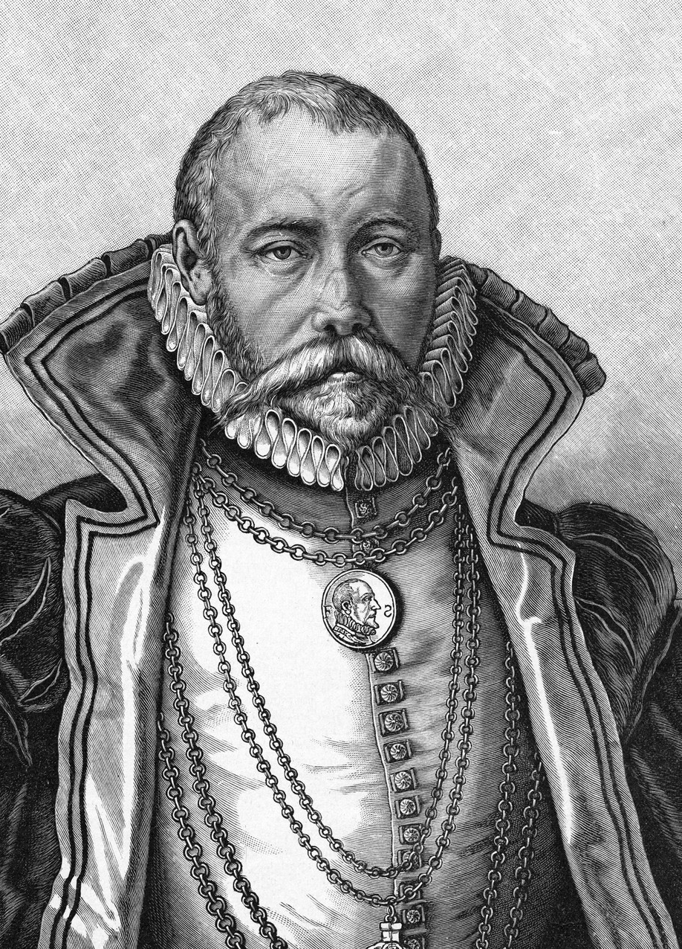
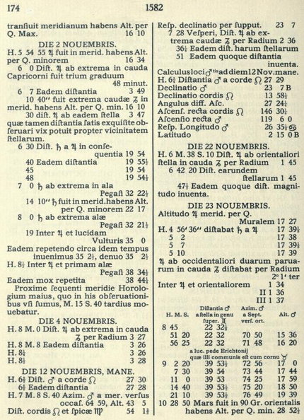
Notes:
In 1600, Kepler is again forced out of his home
this time by the counter-reformation.
He winds up on the doorstep of Tycho Brahe,
the court mathematician of the Holy Roman Emperor.
Brahe has been measuring planet positions for 30 years .
and Kepler knows that this data could have serious benefits for his research.

Slide 14
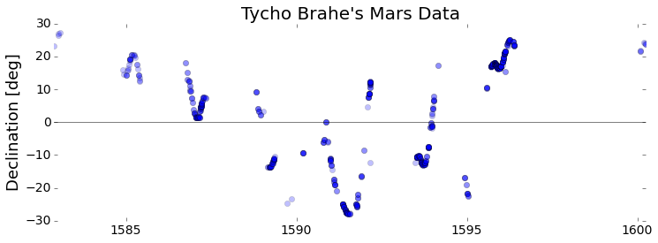
Notes:
However, Brahe is an avid Anti-Copernican, and has his own theories of the solar system.
He wants to use his data to disprove the heliocentric model.
He doesn’t like kepler,
and he doesn’t want to share.
But Kepler is persistent.
He demonstrates his mathematical abilities
and shows Brahe his work on the platonic solids
and finally manages to convince Brahe
to share his observations of a single planet: Mars

Slide 15
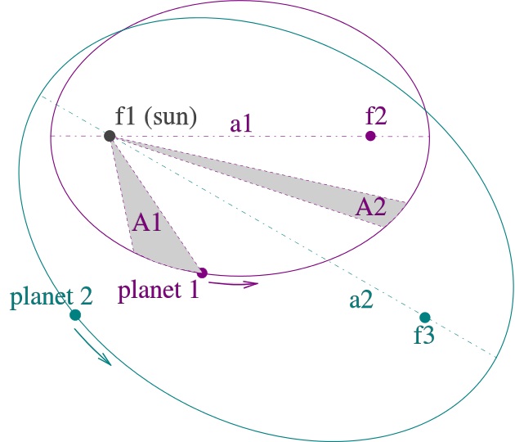
Notes:
Luckily, this is enough!
Over the next few years Kepler
finally discovers that the orbits are elipses,
calculates how fast they move at differernt points in their orbits
and works out how an orbit’s shape influences its period.
He produces a model for the solar system
which is both elegant AND corresponds well with data.

Slide 16
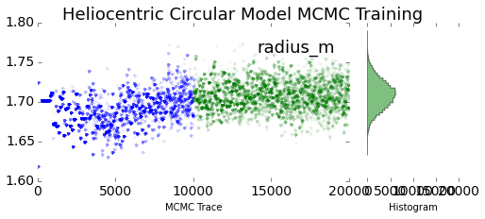
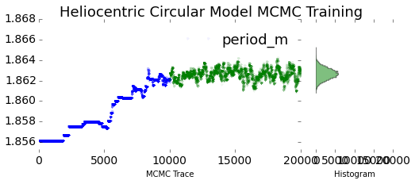
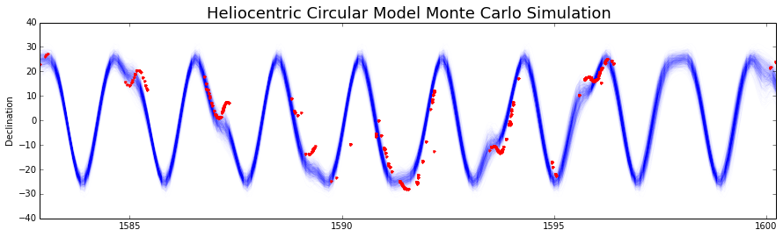
Data Method 4: Parameter Estimation with MCMC
Notes:
Lets look at that correspondence
by using Data method 4: Markov Chain Monte Carlo
to estimate model parameters.
When we use MCMC, our algorithm selects a random set of parameters,
and calculates the likelihood of the observed data given those parameters.
We then randomly choose to include that sample in our output distribution
based upon the likelihood of the data.
We choose a new set of random points based upon our previous values,
and itterate tens of thousands of times.
In these charts we see how with each timestep – shown on the x axis
The set of points moves closer to a final distribution – the histogram in green.
The chart below shows each run of the MCMC, <in blue>
and its correspondence with the data. <in red>

Slide 17
"[Kepler] had to realize that logical-mathematical theoretizing, no matter how lucid, could not guarantee truth by itself; that the most beautiful logical theory means nothing in natural science without comparison with the exactest experience.”
- Albert Einstein, forward to 'Johannes Kepler - life and letters’
Notes:
Over time, Kepler’s theoretical contributions proved to be a major victory for the Copernican Revolution.
His discoveries built support for the heliocentric model,
and were essential for Newton’s discovery of the law of gravitation.
Kepler went on to become Tycho Brahe’s successor as Imperial Mathematician.
Though his persecution continued,
he would write in the preface to the books which promoted his models:
“in the end, the bright light of truth breaks through long lasting clouds of public prejudice;
and when I fight on the side of truth, victory is finally mine”

Slide 18
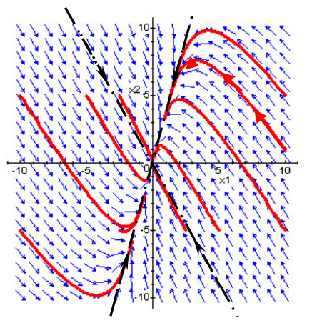
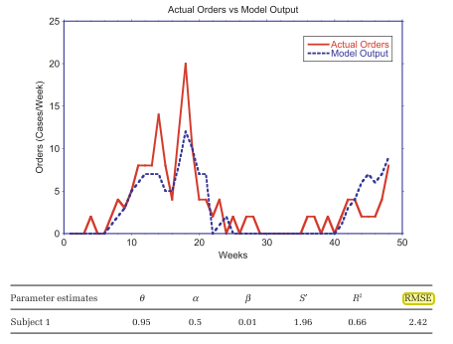
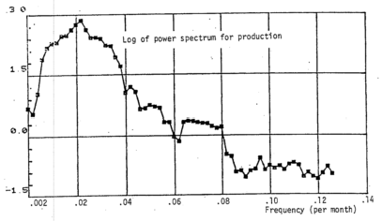
Existing work
Dogan, G: Bootstrapping for confidence interval estimation and hypothesis testing for parameters of system dynamics models
Guneralp: Exploring Structure-Behaviour Relations: Eigenvalues and Eigenvectors versus Loop Polarities
Osgood, N: Bayesian Parameter Estimation of System Dynamics Models Using Markov Chain Monte Carlo Methods
Eberlein, RL; Wang, Q: Validation of oscillatory behavior modes using spectral analysis
Notes:
Just as proper integration of data and models was essential for Kepler,
it is essential for us as System Dynamicists.
Each of the four data methods that we’ve covered so far
are represented in the System Dynamics literature,
Now lets dive into some more methods we find there.

Slide 19
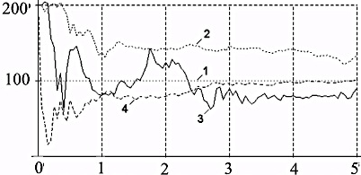
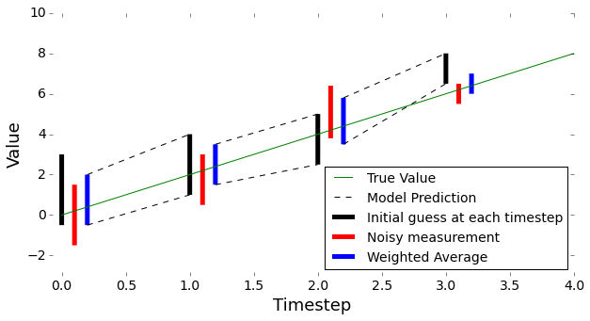
Data Method 5: Kalman filtering for state estimation
Shiryaev et al. Adaptation and Optimal Control of Firm and its State and Parameters Estimation at Change of a Market Situation
% of true value
Weeks
Notes:
Here is an example of Kalman filtering by Shiryaev and company,
applied to a model of a one-commodity production firm.
Kalman filtering lets us estimate the state of a system
given a set of noisy measurements,
and lets us improve our guess as we get more data.
In the top chart, we see Shiryaev’s model successively converge on final values,
as the Kalman filter incoporates new measurements over the course of weeks.
The bottom sketch gives a sense of how the algorithm works.
We start with an estimate of the state value with some uncertainty – here shown as a black bar.
We take a measurement, which due to noise has its own uncertainty – shown in the red bar.
We take a weighted average of the two,
based upon our confidence in each,
and create a best estimate.
We then use this estimate in our model to predict the next timestep’s guess,
and iterate on the process.

Slide 20
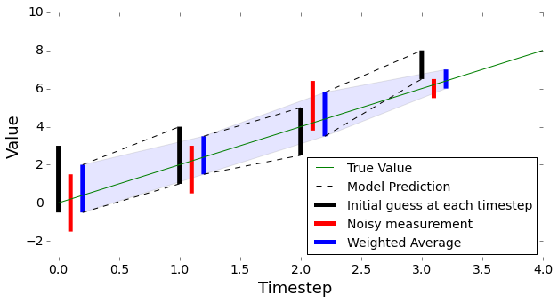
Data Method 6: Kalman filtering for state estimation
Shiryaev et al. Adaptation and Optimal Control of Firm and its State and Parameters Estimation at Change of a Market Situation
% of true value
Weeks
Notes:
In the ideal case, our confidence in the estimate improves over time
here shown as the blue band.
I have stop here and recommend a paper here purely based almost entirely upon its title:
‘A poor man’s explanation of Kalman Filtering,
or How I learned to stop worrying and love Matrix Inversion’
by Roger Du Plessis.

Slide 21
‘A poor man’s explanation of Kalman Filtering, or How I learned to stop worrying and love Matrix Inversion’
by Roger Du Plessis.
Notes:
It’s a good read.

Slide 22
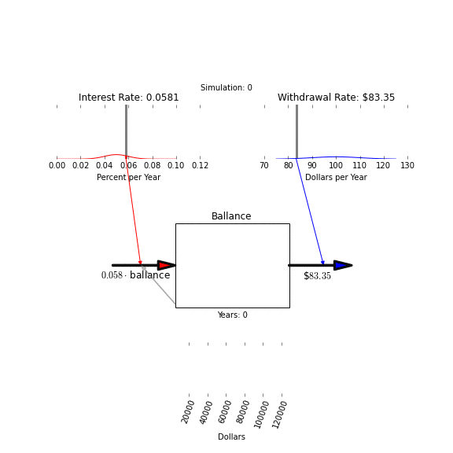
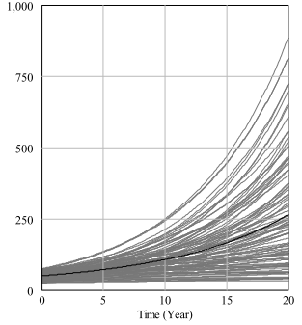
Data Method 6: Monte Carlo for Uncertainty Propagation and Sensitivity Analysis
Ford, A; Flynn, H:
Statistical screening of system dynamics models
Notes:
Now lets…
Use Monte Carlo for forward propagation of uncertainty,
or for estimating the sensitivity of model outputs
to each of the various input components.
We start with a distribution of parameters for a model,
and draw randomly from those distributions. – Here in red and blue.
We then run the model with these input parameters,
and record the output at a point of interest – here in purple.
We draw new inputs
and repeat.

Slide 23
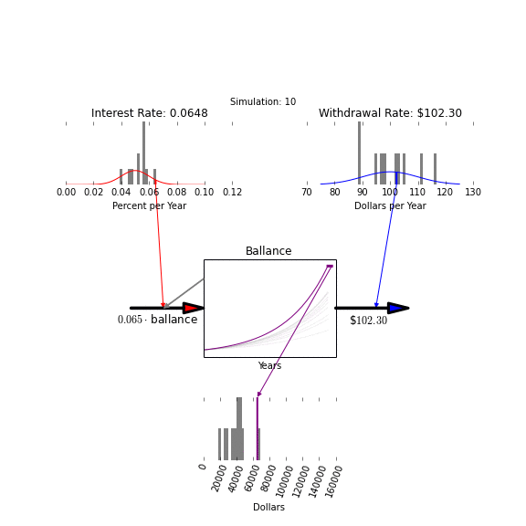
Data Method 6: Monte Carlo for Uncertainty Propagation and Sensitivity Analysis
Workshop on
Statistical Screening:
Thursday at 1:00,
TPM Room 1
Notes:
After doing this a few thousand times,
we have a good approximation of the output distribution.

Slide 24
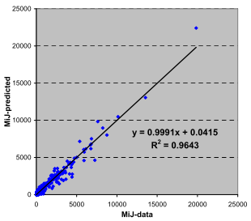
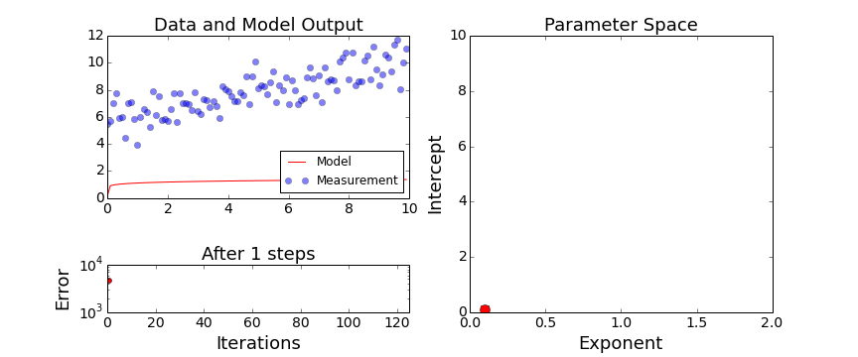
Data Method 7: Parameter Optimization
Data Method 8: Calibration Plot
Measured
Mayerthaler, A: A land-use/transport interaction model for Austria
Optimization Workshop Thursday 10:30, TPM room A
Predicted
Notes:
Optimization is a relatively common technique
we use to fit a model to observed data.
Optimization algorithms work by varying the input parameters
and then measuring the error between
model predictions and observed data.
The algorithm tries to “move downhill” to minimize the error.
Mayerthaler gives an example of using optimization to find parameter values
for a land and transport model in Austria,
And, gives us this cool calibration plot. <in the upper left>
By plotting the model’s predicted values on the x axis,
and the measured values on the y axis,
we can get a quick sense for how good the calibration is.
In the ideal case, all of those points would lie on the 45 degree line.

Slide 25
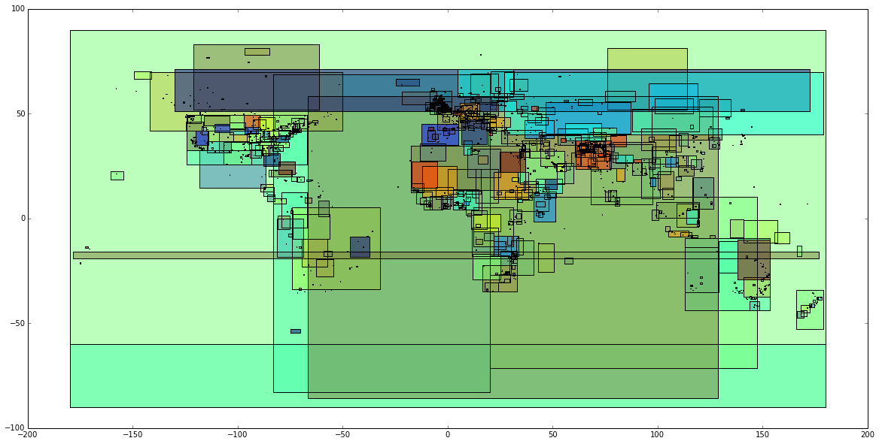
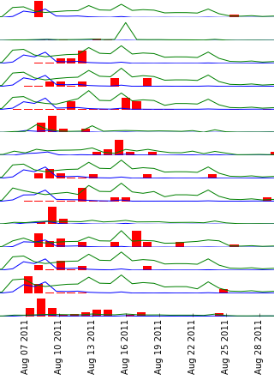
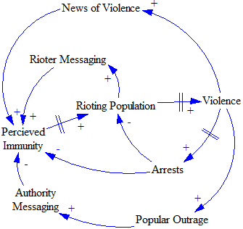
Research Goals:
Blend strengths of top-down System Dynamics modeling with bottom up machine learning.
Integrate SD modeling tools with broader data science offerings
Investigate the possibilities of SD as integrated with modern data streams
Notes:
If its alright with you,
I’d like to show you some of the projects
and data methods I’ve been working with in the last few months.

Slide 26
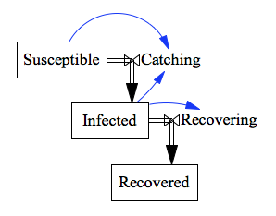
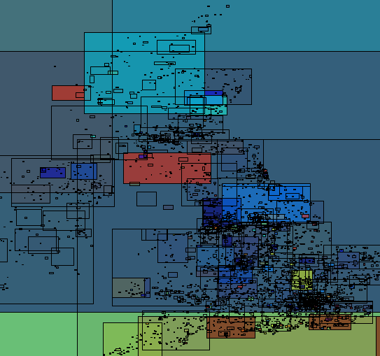
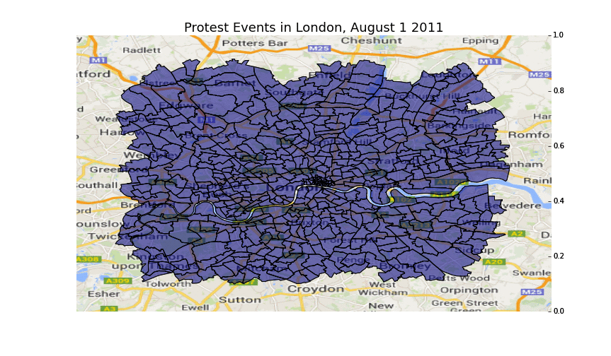
GDELT: 300 million+ rows of event data
x 8,583 geographic regions
Wards of London, August 2011
Notes:
One of our ongoing projects is to try to infer the likelihood that
violent behavior such as rioting or insurgency
will spread geographically,
based upon data from social media.
We’ve been using the riots that occurred in the UK in 2011 as a case study.
The underlying model is essentially an SIR disease propagation model, <as we see in the upper left>
replicated across all the census wards in England and Wales,
with cross-infectivity between wards.
We’ve been working with data from:
‘the Global Database of Events, Locations, and Tone as a measure of violent behavior,
and we get estimates of a ‘susceptible’ population from the UK census.
various twitter filters give us a proxy for active recruitment
We then try to infer, based on the data,
what the propagation parameters are.

Slide 27
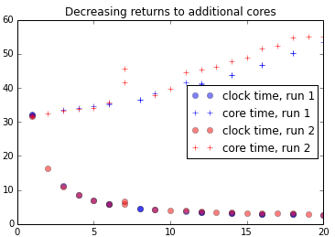
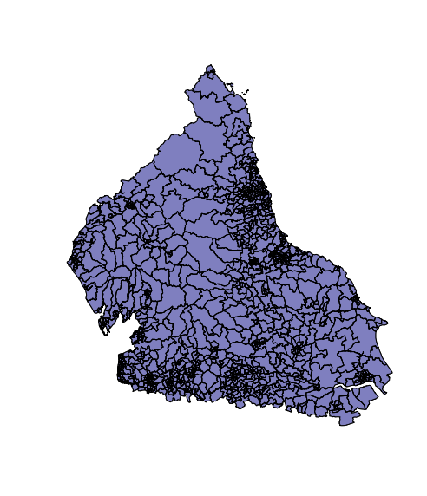
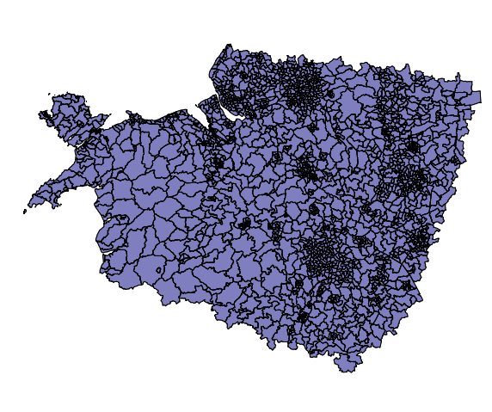
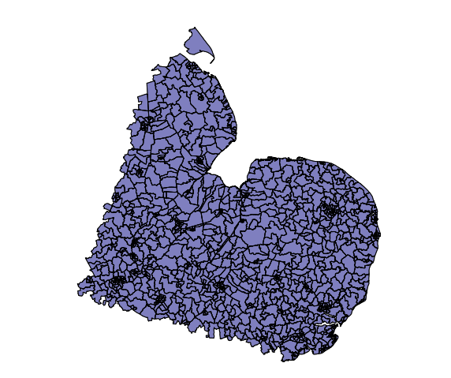
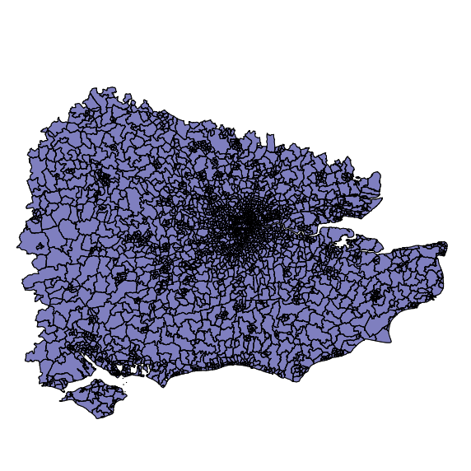
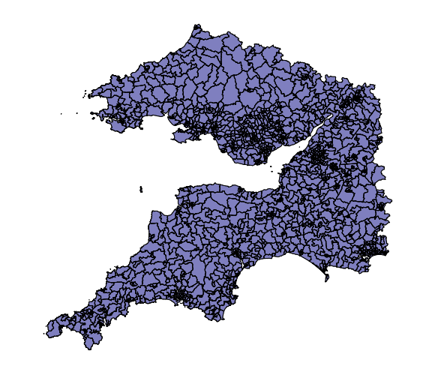
Data Method 9:
Parallelization
Runtime [Seconds/5 iter]
Cores
Notes:
Fitting the model is a challenge, either with simple optimization,
or with Markov Chain Monte Carlo,
due to the large number of runs required.
One of the ways we’ve found to deal with this has been to
first, distribute the geographies across a number of computers, <in this image, 5>
run the simulation one timestep at a time
summarize results before sharing them with other machines.
As we increase the number of cores involved,
we get a bit faster <as shown by the small circles>
but its decreasing returns

Slide 28
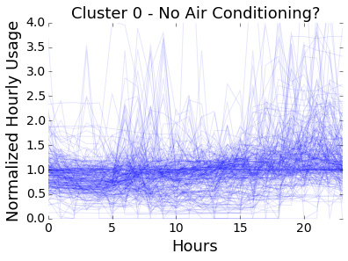
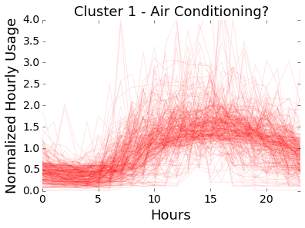

Data Method 10:
Time-series Clustering
Notes:
Another project that I’m working on tries to understand household energy consumption.
Some of these houses have air conditioners, and some don’t,
and we’d like to use different dynamic models for each category.
But we don’t know which is which.
We don’t even know in advance what air conditioning usage looks like.
We do know that houses with air conditioning look more alike to one another than they do to houses without,
as they are all exposed to the same temperatures. <here in black>
If we use a clustering algorithm to separate about 500 homes into two groups, those pictured here,
we can see that there is a clear difference in behavior, likely indicative of the presence of AC.

Slide 29


Data Method 11: Principal Component Analysis/
Linear Discriminant Analysis
LDA
Notes:
For another project, we are Interested in modeling polarization in
the dialog between social groups, over time.
Before I explain the project, I’ll explain Data Method 11: Linear Discriminant Analysis
Assume we have a set of points in N-dimensional space <here, this is in 3 dimensions>
belonging to one of two groups <here, red and blue>
Linear Discriminant Analysis allows us to reduce those N dimensions
to a smaller number, <here we go from 3 to 2>
where the groups are most separate from one another.

Slide 30

Data Method 11: Principal Component Analysis/
Linear Discriminant Analysis
LDA
Primary bias:
“MNLF gunmen”
“MNLF rebels”
“MNLF members”
“military said”
“Zagala said”
“hostages”
Secondary Bias
Primary Bias
Notes:
Can you see how this relates to dialog polarization?
We start with a set of group-identified news and social-media documents
coded by a concept identification engine
to give us points in N-dimensional space
one for each document
We then use LDA to identify dimensions of difference between groups.
We then measure group movements along those axes
which these become our metric for polarization

Slide 31




BONUS Data Method: Visualization
Notes:
Because you’re such a great audience,
I’m going to throw in a bonus data method:
Visualization.
We’ve been using a variety of visualizations throughout this presentation
to look at models and data,
and stimulate the world class information processing algorithms
present in our brains.
On this slide, there are four different visualizations that look at the same set of data in different ways,
and reveal different lessons.
Don’t forget that sometimes a fresh perspective is all it takes
to understand the system.

Slide 32
General Data Challenges
Timeseries data gathering, storage, formatting, verification, transformation, interpolation and alignment
Geographic data manipulation
High speed numerical integration
Multiprocessing
Statistical analysis
Machine Learning algorithms / Neural Networks / AI
Optimization Techniques
Real-time or interactive data visualization in web formats
Theory/Documentation/Code/Result colocation
Real-time collaboration/Version Control
Open Sourcing/Archiving/Facilitating Replication
Notes:
There are a number of challenges for integrating data and models
that are not unique to System Dynamics, and
the biggest is this first one.
In these situations, we should use existing tools
rather than duplicate functionality within our own modeling environments.
This allows us to take advantage of ongoing work of our colleagues in other disciplines
while focusing our development efforts on challenges that are unique to System Dynamics.

Slide 33

Notes:
There are a variety of external tools we can take advantage of
in a variety of combinations.
Instead of telling you which are ‘the best’, I’ll share with you
the set of tools that I use, and find to be helpful.
Firstly, I use python as a computational environment, because its free and easy.
It is also increasingly well supported by the data science community
a few of the major modules are listed here.
To make sure my work can be replicated,
I use the iPython notebook,
which combines text, equations, code, and results
in a web-native fashion
And I use github for versioning and sharing my analyses with other modelers.
To practice what I preach,
the Kepler examples from this talk can be
found at github.com/JamesPHoughton/kepler

Slide 34

Future Projects?
Python-ready XMILE-based SD execution engine
iPython widget based on SD.js
Notes:
Here’s a couple things I have in mind for future projects:
First, to create/coopt an SD engine that reads XMILE format,
that integrates smoothly with the python Data Analysis stack
Second, to work with Bobby Powers’ javascript SD engine
to display models within the iPython environment.
If you’re interested in collaborating on these projects,
get in touch with me.

Slide 35
Contact me: houghton@mit.edu
Example Code: github.com/JamesPHoughton/kepler
Kepler Sources
Data:
CSV Format: http://www.pafko.com/tycho/observe.html
Latin Original: https://archive.org/details/operaomniaedidit12brahuoft
Biography:
Baumgardt, Carola. “Johannes Kepler: life and letters”. Victor Gollancz, 1952.
Connor, James A. "Kepler's witch: an astronomer's discovery of cosmic order amid religious war, political intrigue, and the heresy trial of his mother.” New York: Harper, 2004.
Notes:
We’ve discussed 11 data inclusion methods,
Told a (hopefully interesting) story
And had a few previews into ongoing and future work.
You can find a total of 23 data methods,
organized by modeling phase,
with tutorials, explanations, and examples
in the paper that accompanies this talk.
That paper, this presentation, and the Kepler examples
are all shared in this Github repository.
At this point, are there any questions?

